Slide 1
Capstone Design Proposal Presentation

Slide 2
Hello!
We are “LAJI”
-Jisu An
-Hyunjae Lee
-Jinwoo Jeon

Slide 3
Meet the Team
1
ㅇ
AN JISU
LEE HYUNJAE
JEON JINWOO
Jane Doe
Jane Doe
Jane Doe
BACKEND DEVELOPER
FRONTEND developer
FRONTEND DEVELOPER
Sever, Toss Api, Database
Dashboard UI, Database, Toss Api
Highlight algorithm, Twitch Api, UI
ajs7270@gmail.com
leehj8687@email.com
zinuzian@gmail.com
Notes:
© Copyright Showeet.com – Creative & Free PowerPoint Templates

Slide 4

Introductions
What needs do we have?

Slide 5

Introductions
What do we interest?

Slide 6

Introductions
There are some intersections

Slide 7
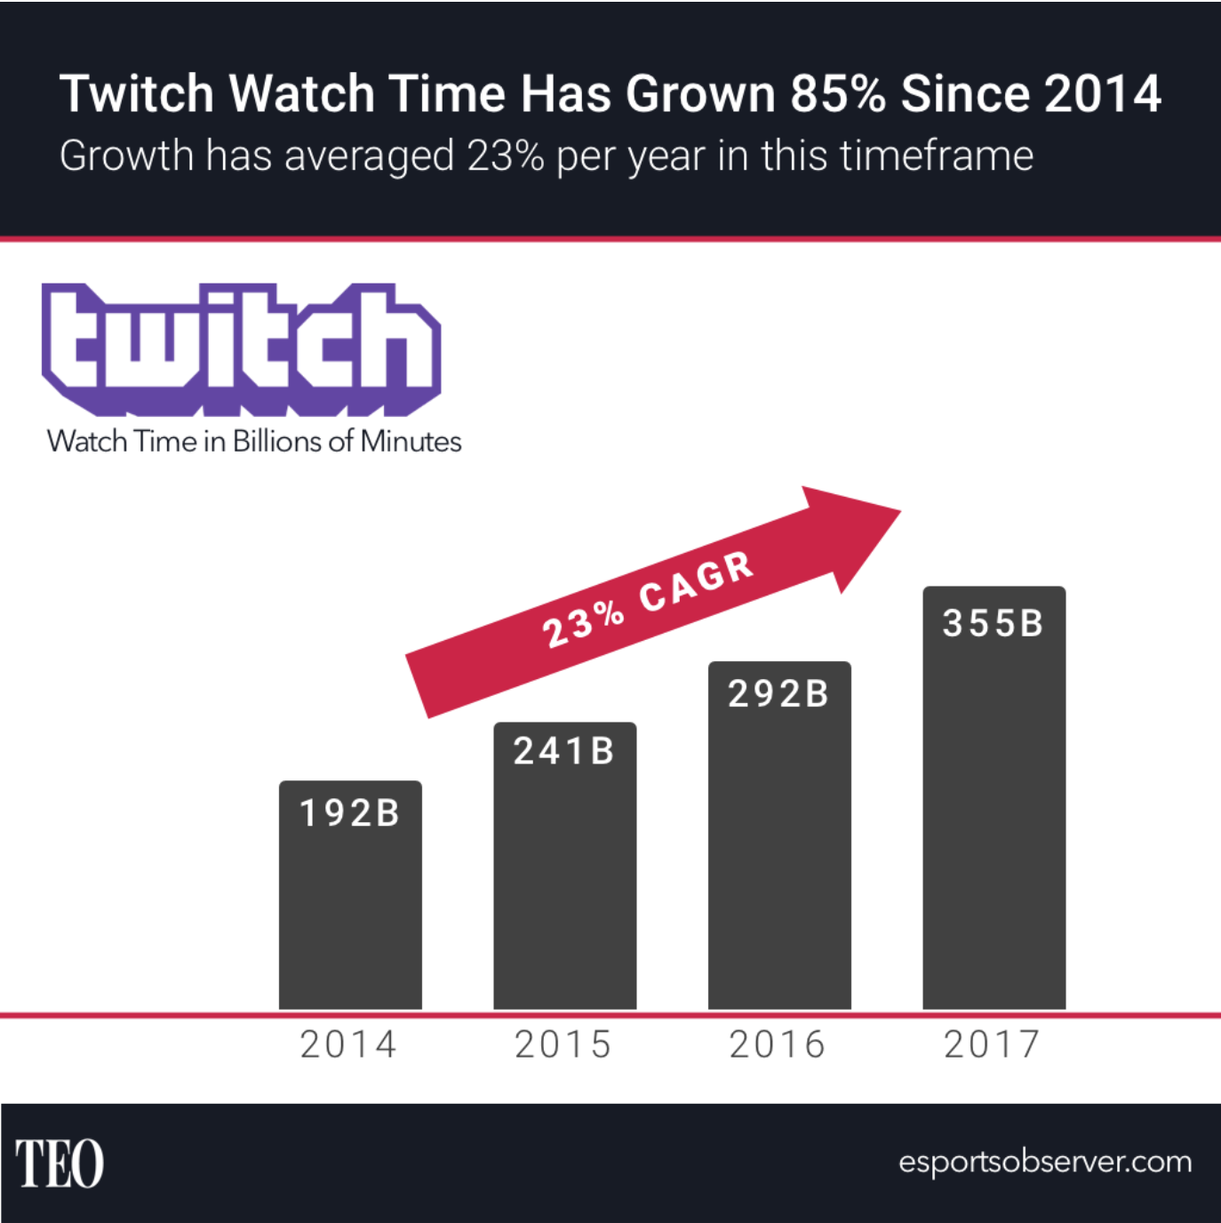

Introductions
Online streamer is a person who broadcasts themselves online through a live stream or pre-recorded video
Twitch is a live streaming video platform … primarily focuses on video game live streaming …
Notes:
저희가 정한 토픽들입니다.
여기서 어떤 사회적인 니즈가 발생하는가하면, 컨텐츠를 제공하는 스트리머들도 많아지고 이를 시청하는 소비자들도 많습니다.
하지만, 소비자들의 컨텐츠 소비시간은 한정되어있고, 이 시간내에 스트리머들은 자신의영상을 보게끔해야합니다.
주목을 끌만한 컨텐츠를 제공할 수도있지만, 이를 짧은 길이의 영상으로 편집하여 제공하는것도 하나의 중요한 포인트입니다.
하지만, 이를 편집해줄 영상편집자들은 고급인력입니다.

Slide 8
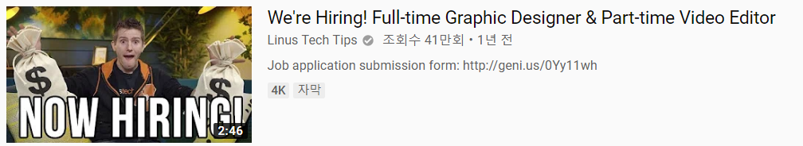
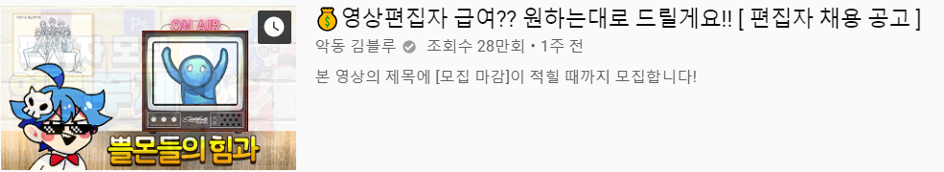
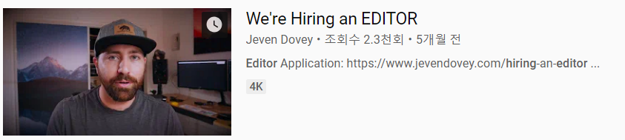

Slide 9
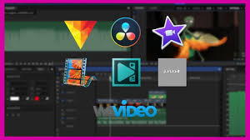
Motivations
Needs: Professional video editors.
But, It’s hard to get one.

Slide 10
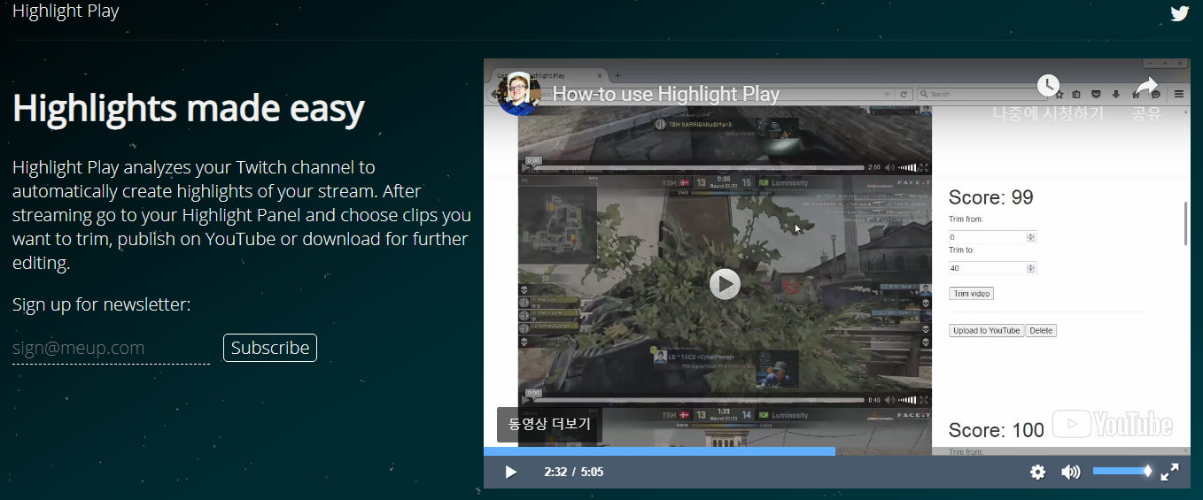
Market Research
Highlight Play

Slide 11
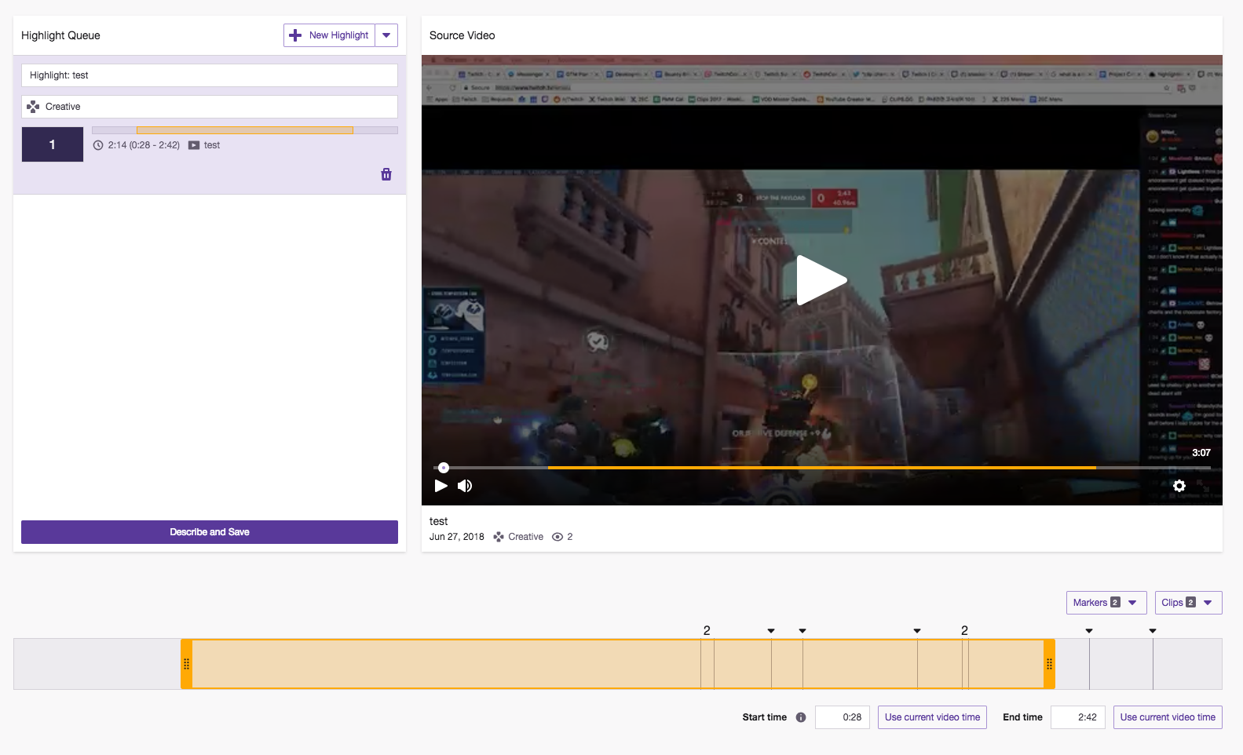
Market Research
Twitch

Slide 12
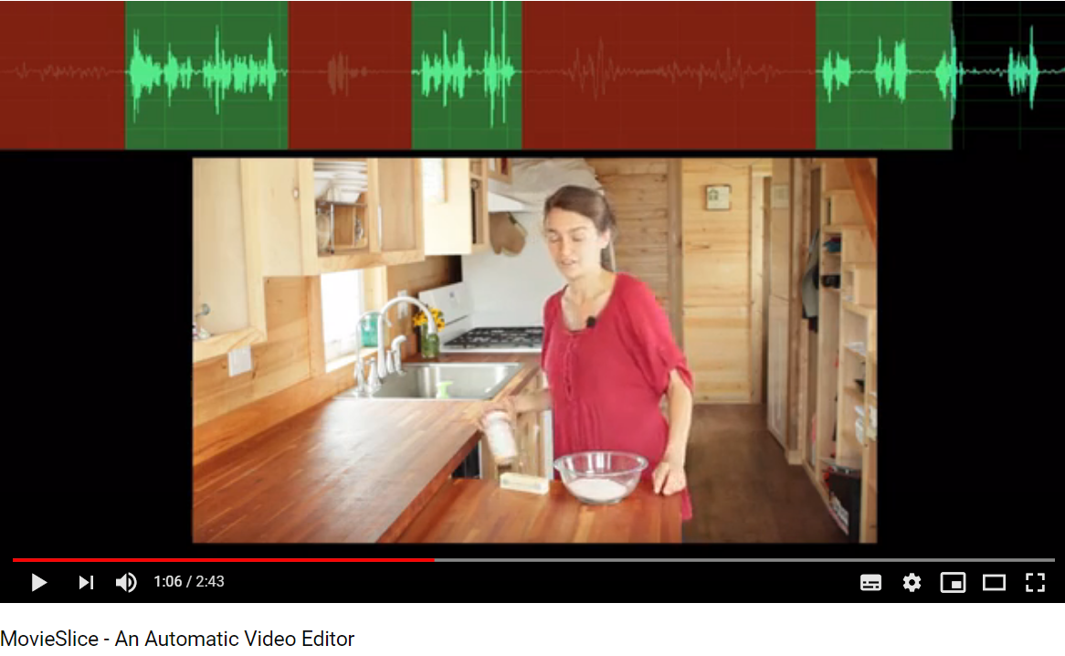
Market Research
MovieSlice

Slide 13
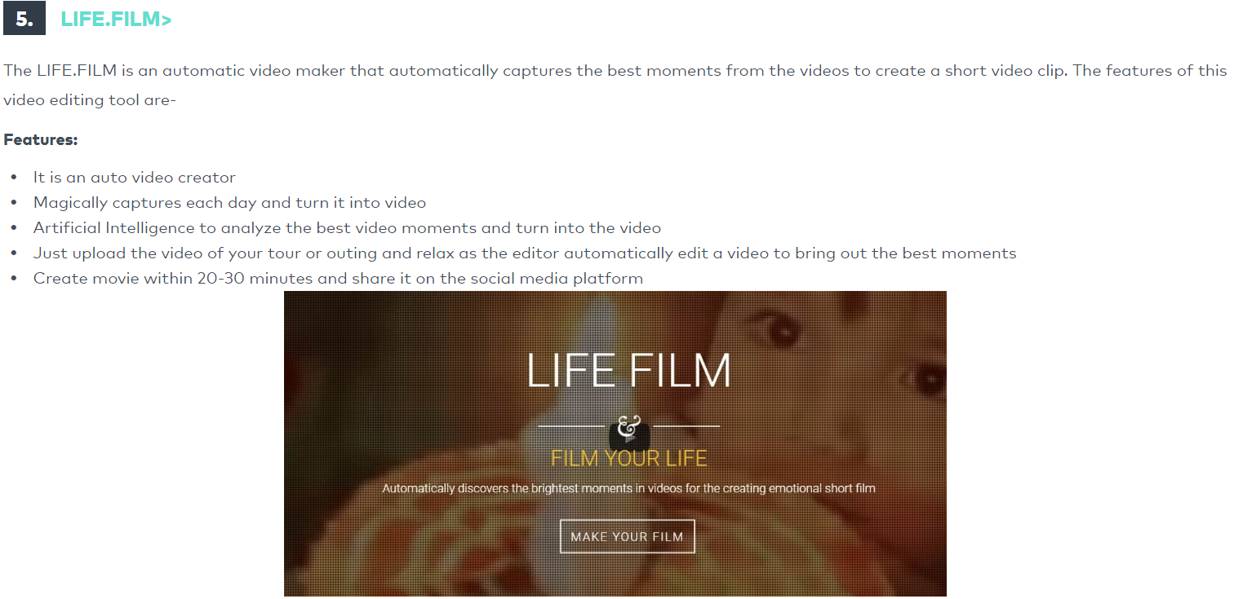
Market Research
LIFE.FILM

Slide 14
Introductions
So, we propose “Auto video editor” for game streamer on Twitch by English

Slide 15
Introductions
So, we propose “Auto video editor” for game streamer on Twitch by English
Remarkable features..(Goals)
Twitch chat analyze
With face & speech recognition
High scalability

Slide 16
Development plans
UI(1) - Login
Security(https)
Login form
(Social media)

Slide 17
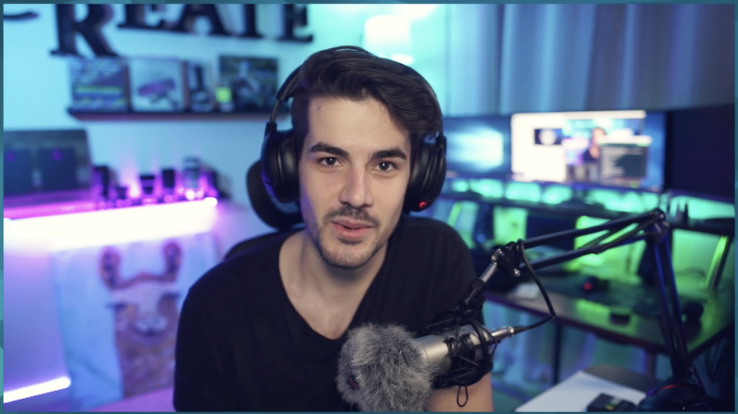
Development plans
UI(2) : Main
Image from video
Upload
Delay(Int)
Face Recognition ▣
Speech Recognition▣
Chat Recognition ▣
Analyze
Notes:
Upload->랜덤한 이미지선정 -> 방송자 화면을 방송자가 직접 frame 설정(영상분석 속도향상 기대)
Delay는 나중에 하이라이트 알고리즘을 개발할때 필요할 수도 있을거라고 예상하였습니다. 이부분은 선택적입니다
그리고 방송자(사용자)가 얼굴/음성/채팅분석을 체크박스로 선택한 후 analyze버튼을 누르면 서버에서 처리.
이 때 저희가 예상하는 처리 방식은, 얼굴/음성 분석에서 하이라이트가 될 가능성이 높은 특정시간들의 아웃풋과 채팅분석에서 하이라이트가 될 가능성이 높은 특정시간들의 아웃풋의
교집합을 하이라이트가 될 가능성이 높다고 판단하는 것.

Slide 18
Development plans
UI(3) : Download & History
Download
Rendered Video (1)
Rendered Video (2)
Rendered Video (3)
Rendered Video (4)

Slide 19
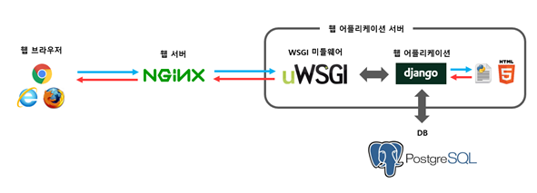
Development plans
Web-App Server
<Set-up>
Operating system: ubuntu 16.04
Web server: NginX
Web Framework: Django
WSGI MiddleWare: uWSGI
Database server: PostgreSQL
Security: http over ssl (https)
Server specification : AMD Ryzen 2400g (our own)

Slide 20
Development plans
<Features>
Login
Payment System(Toss)
Large file upload and download (upto 4GB)
Face & Speech Recognition
Highlight algorithm
Video merging and rendering
Notification mail
History

Slide 21
Development plans
Week | Plan
1st | Idea & Proposal
2nd | Idea & Proposal
3rd | Server construction (Configuration setup : Nginx, domain(bind9), https), Test videos (Twitch/Game/Eng)
4th | Login (SNS), Database
5th | Video upload & download, Twitch chat API analyze
6th | Frame resizing, Web UI, Designing highlight algorithm
7th | Demo

Slide 22
Development plans
8th | Highlight video analyze algorithm development and test
9th | Highlight video analyze algorithm development and test
10th | Highlight video analyze algorithm development and test
11st | Toss (payment), Test
12nd | Notification mail, Server test
13rd | Preparing for Final demo
14th | Final demo
15th | Final report

Slide 23
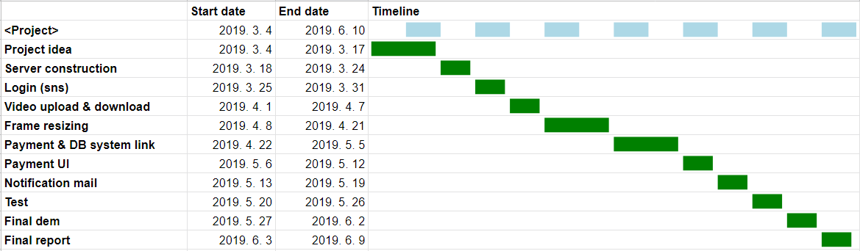
Development plans
Jisu An,

Slide 24
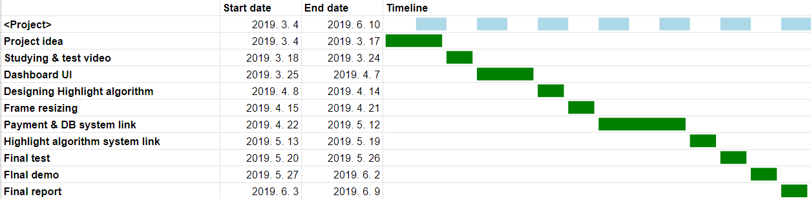
Development plans
Hyunjae Lee,

Slide 25
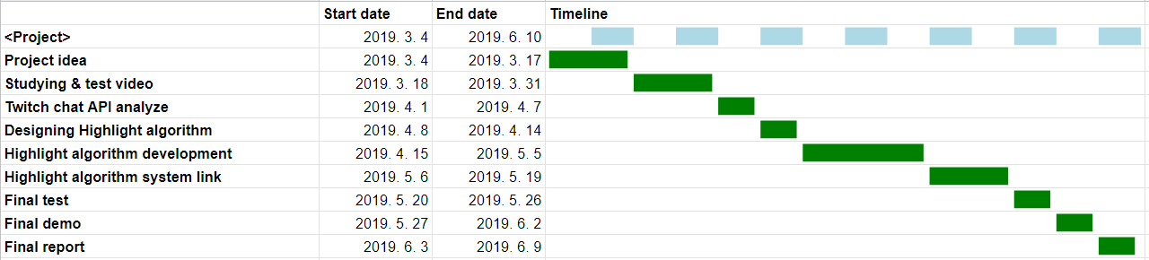
Development plans
Jinwoo Jeon,

Slide 26
Thank you!

